Slide 1
Sage Intacct
New Starter Guide

Slide 2
Where to Start
4. Sage University
Register for and take on-demand courses across a range of roles and functions.
5. Sage Community
Join the Sage Intacct Community, and you can:
Get and give advice and recommendations
Join groups and collaborate with other users
Quickly find answers in the knowledge base
6. Acuity24 Support and the Acuity Community
Contact Acuity24 Customer Success and Support – we are here to help!
Login into the Acuity Community to raise a case and find more help.
1. Getting a user set up
Speak with your Sage Intacct administrator to get your user set up.
They may need to arrange for an additional licence to be added. This can be arranged with your Acuity24 Customer Success Coach.
2. Help Centre
Access the Sage Intacct built-in Help Centre that provides step- by-step instructions on using the system.
From here access a library of videos to guide you through common workflows.

Slide 3
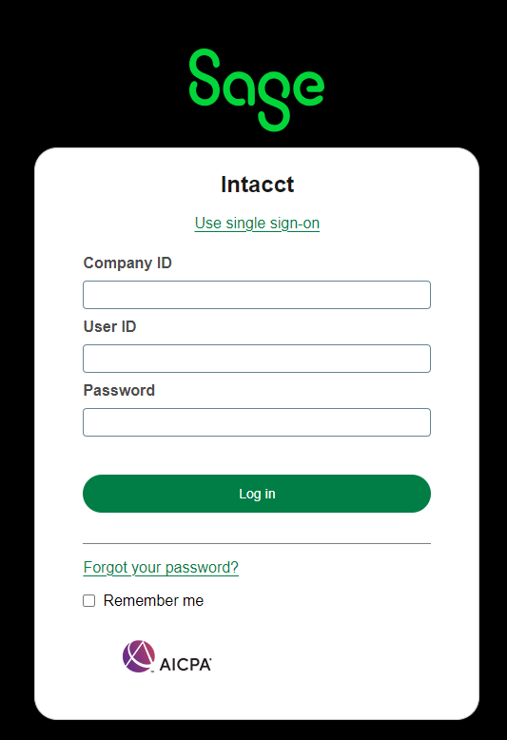
Log in
Once your Sage Intacct user has been set up you will receive an email to complete the set up and login to the system.
Login to Sage Intacct at:
https://www.intacct.com/ia/acct/login.phtml

Slide 4
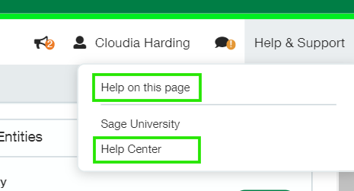
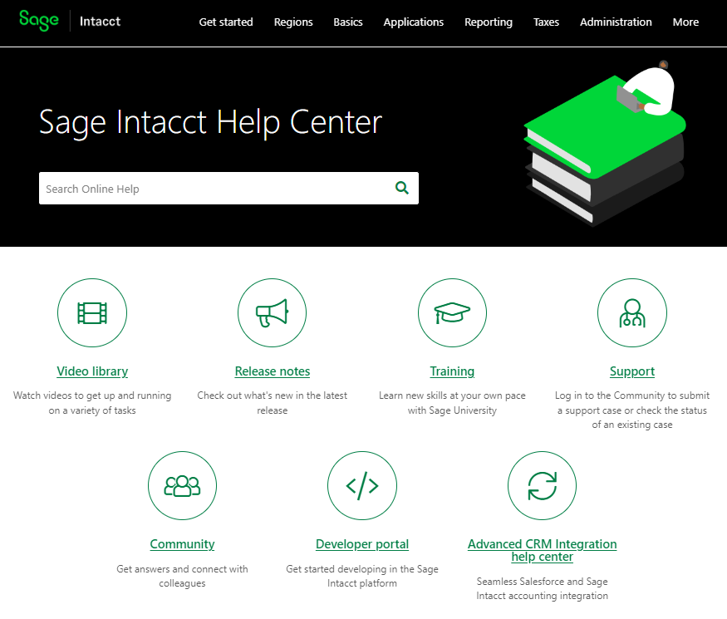
Help Centre
Get help from within Sage Intacct by going to Help & Support in the top right corner or your page.
Help on this page
Get immediate answers for the page you’re on.
Step-by-step, field descriptions, and troubleshooting.
Help Centre
Searchable, browsable answers.
Release notes and videos.
Library of “how to” videos, by subject.
Easy access to other resources.

Slide 5
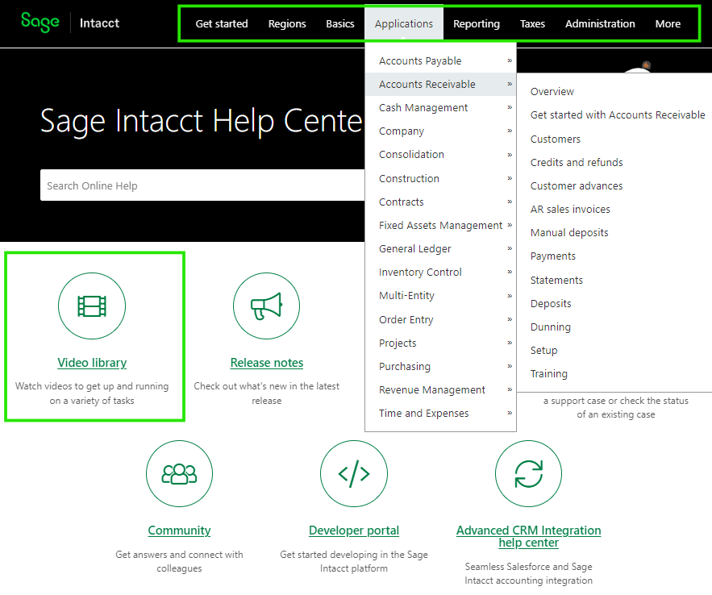
Help Centre
Use the menu to view the basics or application specific processes or use the search box to find what you are looking for.
Access the video library to view a range of short videos on key processes.
New to Sage Intacct quick reads can be found here

Slide 6
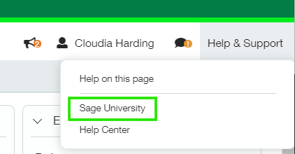
Connecting to Sage University
The Sage University provides training courses and short video tutorials to help you develop your skills and get the most out of Intacct.
Login or Create your Sage account
Log in with your Sage account email address and password or create account at the bottom of the Login page.
When creating your Sage University profile, be sure to enter your Sage Intacct Customer ID in the Account Number field. This ensures that you receive access to learning benefits associated with your organisation.
[You can get your Customer ID by contacting the Acuity24 Implementation, Customer Success or Support team.]
To Access Sage University • In Sage Intacct’s top tight hand corner Click Help & Support > Sage University.

Slide 7
Sage University – Free courses
There are a mixture of free and chargeable courses on the University and a number of learning pathways depending on your role and experience.
If you are new to Sage Intacct, Sage Intacct Fundamentals On-demand (UK) is a great starting point! This module takes you through navigation and performing key accounting functions and common
procedures, such as:
entering purchase invoices
Making and receiving payments
entering invoices
reconciling bank statements and credit cards.
Modules also give access to virtual lab environment for 14 days so you can apply and practice new skills without the worry of impacting your live system.
If you are a new admin, try Managing Users, Roles, and Permissions

Slide 8
Example Learning Pathway
1
Get Started
On-demand intro course to help you navigate the system
2
Fundamentals
Teaches you how to navigate and perform accounting functions using SI
3
Working with Budgets
Shows you how to add, import, modify, and manage budgets in the system.
4
Working with Multi-Entity Shared Environments
Teaches you how to navigate and
transact in multi- entity shared environments
5
Learn More
Additional courses available to dive deeper into product functionality by module.

Slide 9
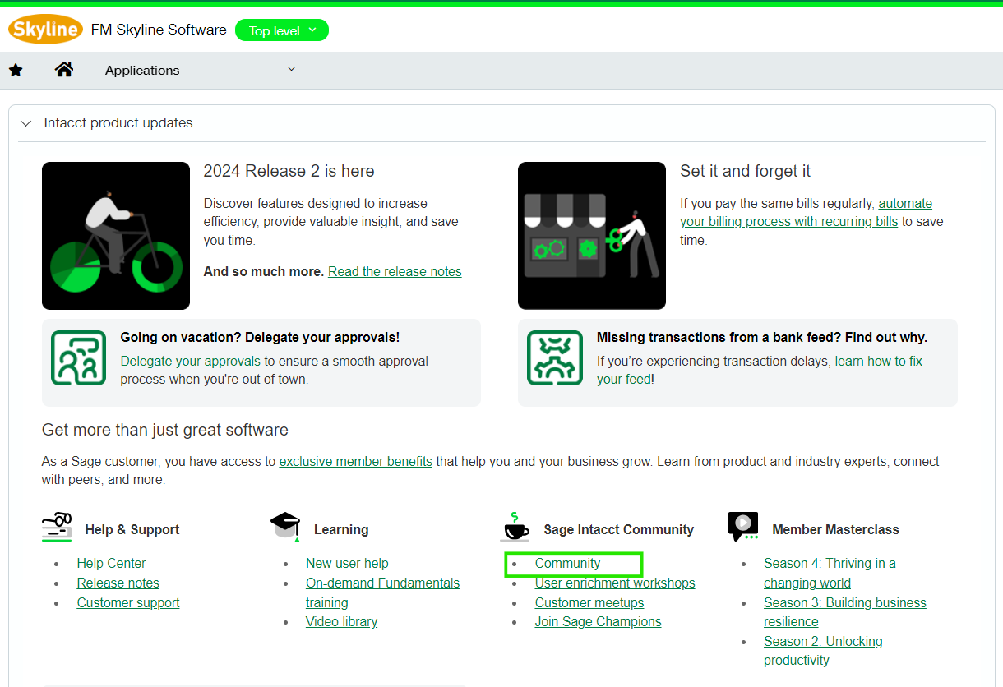
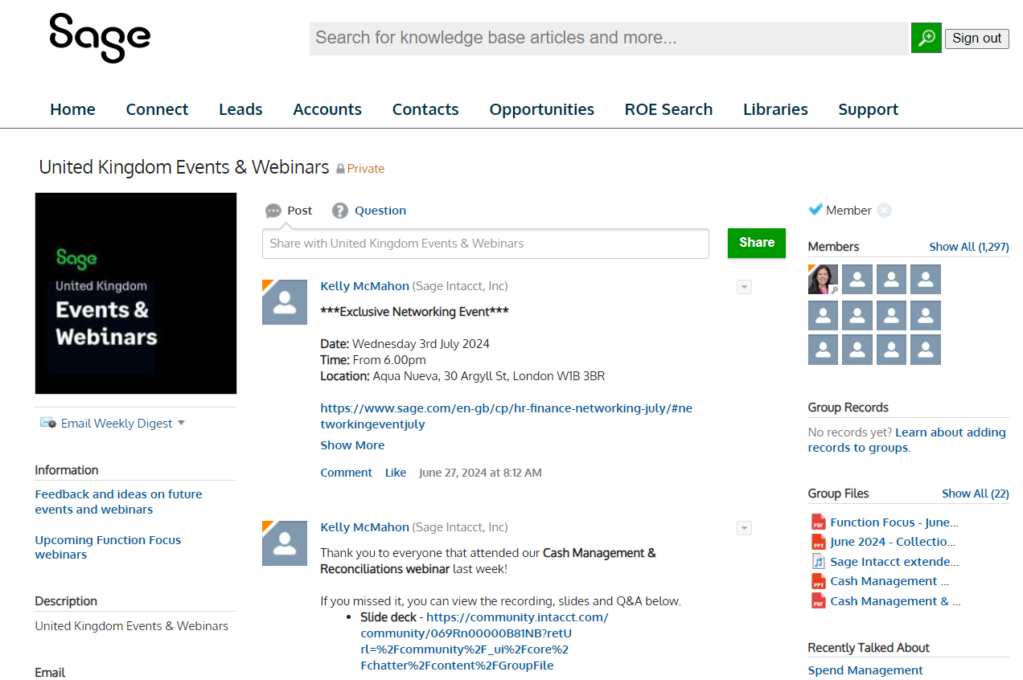
The Sage Community
The global Sage Community is the place where you can:
Ask questions of your peers – Join the Sage Intacct Community Group
See weekly tips and tricks
Research the knowledge base
Log and vote on IDEA’s for Sage Intacct
Ask a Question on the Community
Register for webinars – via United Kingdom Events & Webinars
Sign up to the community from the Sage Intacct homepage, the help centre or click here.

Slide 10
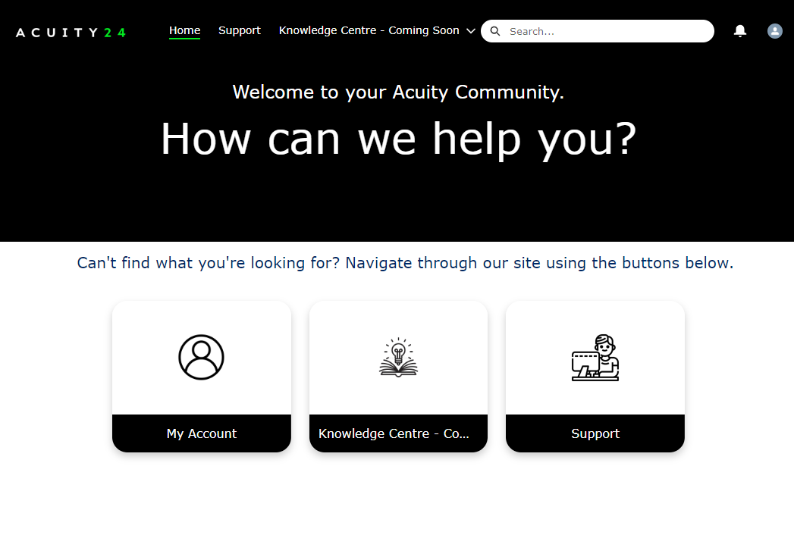
Acuity24 Support and Acuity Community
We are here to help!
Contact our support team with any questions you may have at:
Support
Email: sageintacctsupport@acuity24.com
Phone: +44 1932 237110
Or login to the Acuity Community Here to raise, view or update your cases.

