Slide 1
Get Started with the Sage University

Slide 2
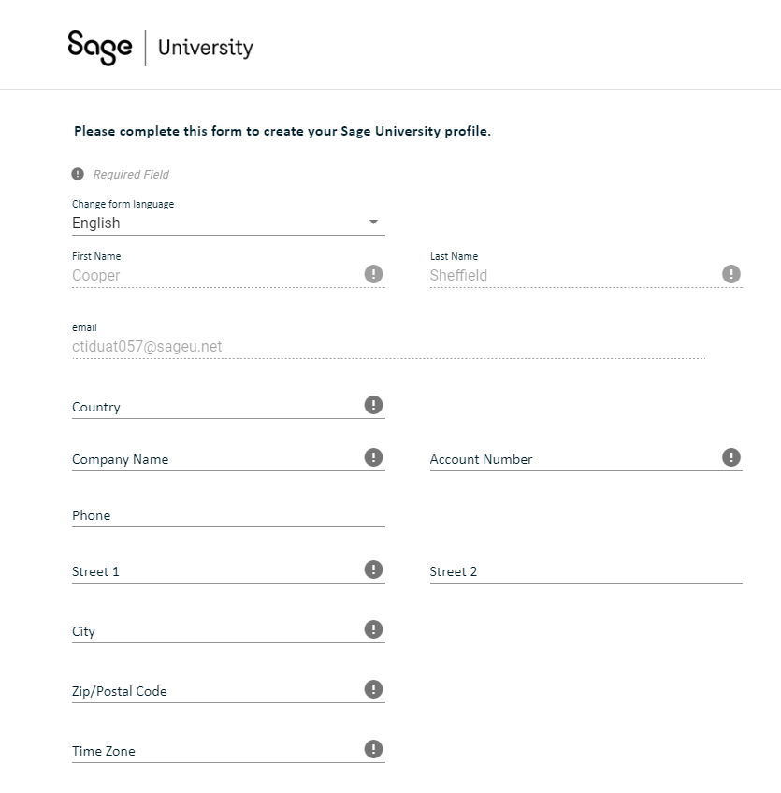
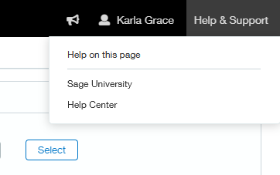
Accessing the Sage University
New to Sage Intacct learning? Complete your Sage University profile to get started by clicking below or access directly from Sage Intacct at Help & Support > Sage University: Link here.
When creating your Sage University profile, be sure to enter your Sage Intacct Customer ID in the Account Number field. This ensures that you receive access to learning benefits associated with your organization.
[You can get your Customer ID by contacting the Acuity24 Implementation, Customer Success or Support team.]

Slide 3
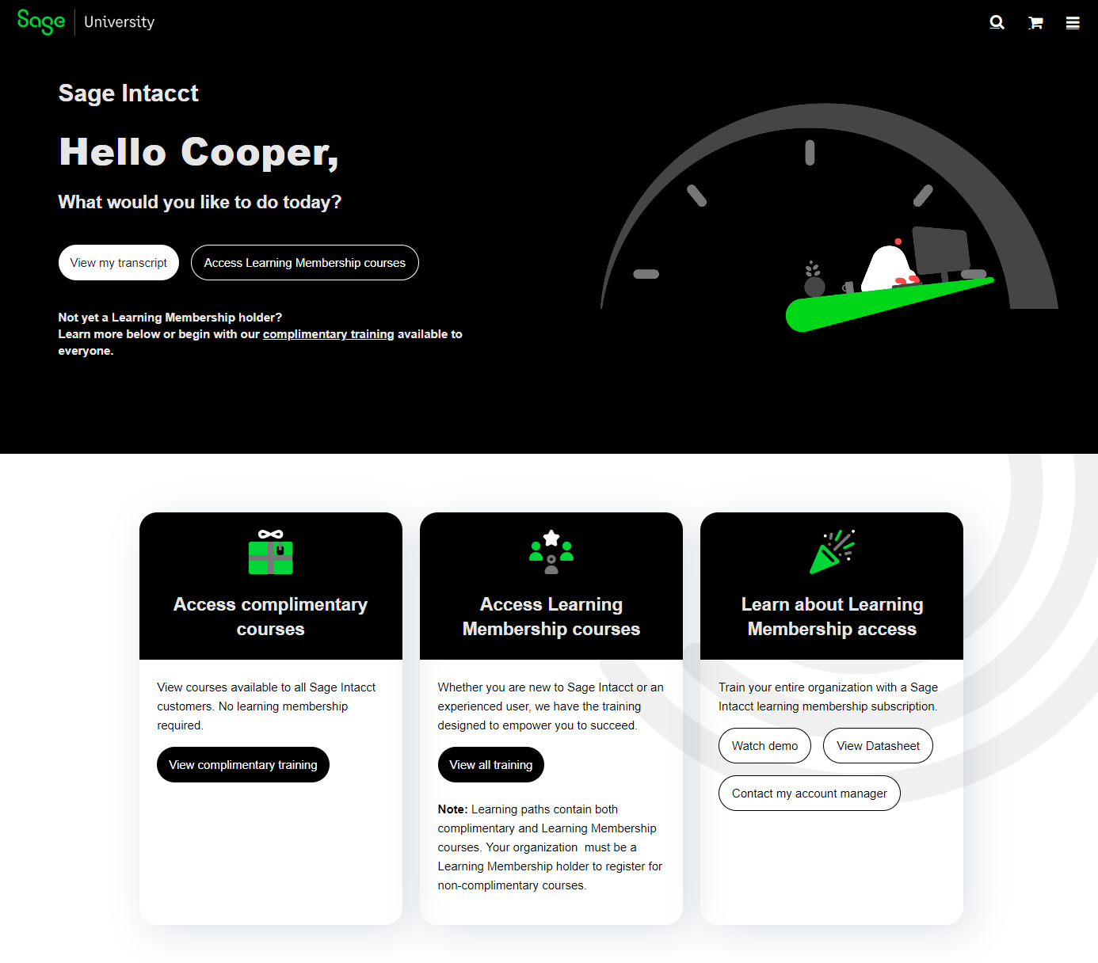
Complimentary Training Courses
Once logged in all users can access complimentary Sage Intacct courses with a Sage account at Any Time!
New to Sage Intacct? Take complimentary training during implementation to prepare for success.
New User? Take complimentary courses to familiarise yourself with navigation and key processes.

Slide 4
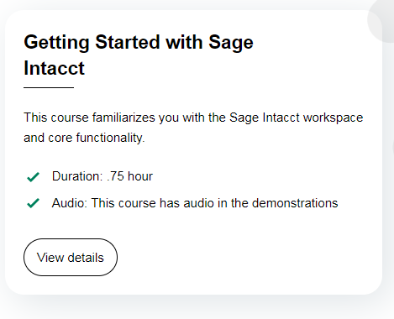
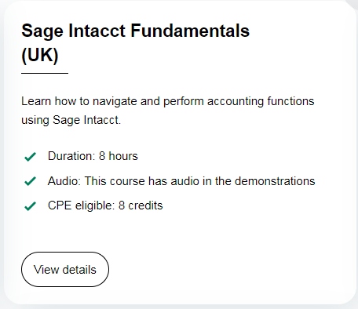
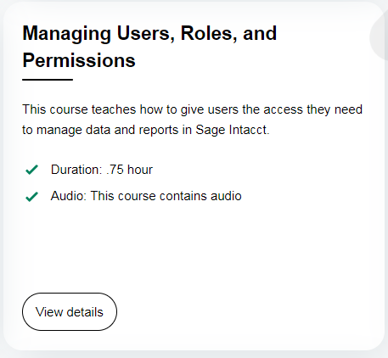
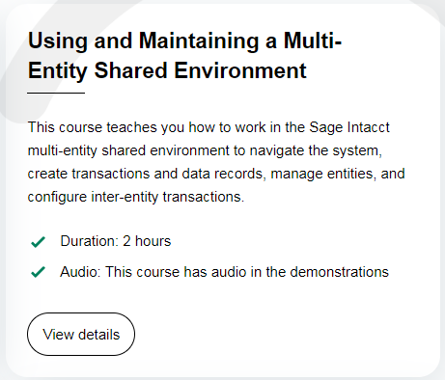
Learning Pathways
Explore the Course catalogue, release notes, video library or work through role-based learning pathways:
Accounts Payable Specialist
Accounts Receivable Specialist
Controller/Accountant
System Administrator
Projects
New User? Begin your learning with ‘Getting Started with Sage Intacct’ and ‘Sage Intacct Fundamentals’
System Administrator? Level up with ‘Managing Users, Roles and Permissions’

